Slide 1

Academic Journal Publication System
Name : B. M. Sharier Kabir
ID : 1285464
Course : Web and Mobile App Development using Spring Boot,
Android & Flutter
Round : 62

Slide 2
Project Overview
1
Platform Overview:
The Academic Journal Publishing System is a comprehensive web-based platform.
2
Purpose:
It aims to enhance and automate the complete lifecycle of scholarly journal publication.
3
User Roles:
The system supports multiple user roles, including:
Authors
Editors
Reviewers
Admins
General Users
4
Core Functionalities:
The platform provides seamless features for:
Manuscript submission.
Peer review process.
Editorial workflow management.
Journal and issue management.
Final publication of articles.

Slide 3
Technical Overview
1
Frontend:
Node.js (version: 22.14.0)
Angular (version: 19)
Bootstrap (version: 5.3)
2
Backend:
Java (JDK 21)
Spring Boot (version 3.4.4)
Spring Data JPA.
Hibernate.
3
Database Layer:
PostgreSQL (version: 17.4)
4
File Storage:
Supported files: .zip, .pdf, .doc, .docx
Local Server Storage.

Slide 4
Core Functional Modules (1/3)
User Authentication & Role Management:
Registration & Login (with email verification).
Roles: Author, Editor, Reviewer, Admin, General User.
Permissions defined per module based on user type.
Manuscript Submission Workflow:
Multi-step form with autosave.
File upload with format validation (.doc, .docx, .pdf, .zip).
Status transitions (Submitted → Under Review → Revision → Accepted/Rejected → Published).
Integrated version control system for multiple submissions.

Slide 5
Core Functional Modules (2/3)
Peer Review & Editorial Workflow:
Reviewer assignment and access control.
Inline feedback / comments, and decision logging.
Editor dashboard for managing submissions.
Post-publication updates (corrections / retractions).
Admin Panel:
Manage users, roles, permissions.
Assign reviewers / editors to journals or articles.
Journal and issue creation tools.
Submission lifecycle overview dashboard.
Analytics (submission rates, acceptance ratios, reviewer activity).

Slide 6
Core Functional Modules (3/3)
Public-Facing Website (Publisher Frontend):
Journal listings with metadata (scope, editorial board, archives)
Issue browsing and article viewing (abstract + full text / PDF links)
Public user registration for article alerts and profile creation
Search functionality by keyword, author, DOI, etc.

Slide 7
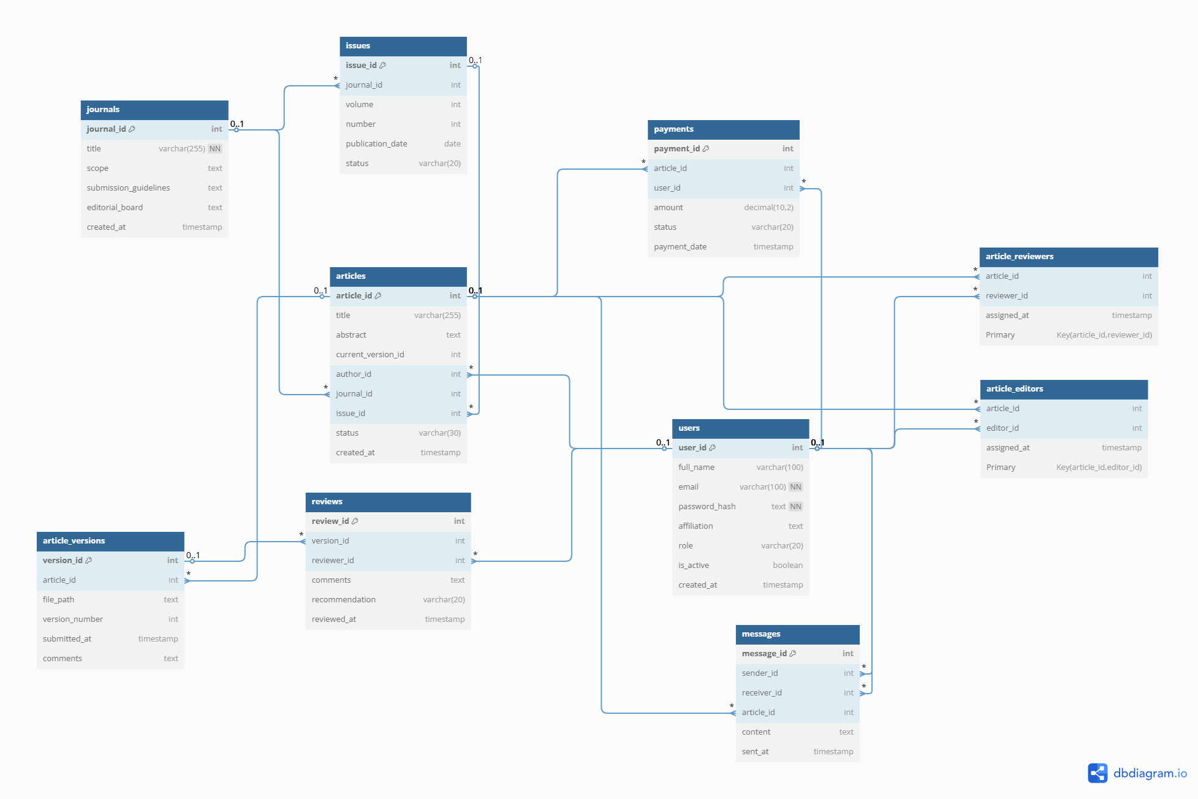
Entity Relationship Diagram (ERD)
Name of Tables:
Users
Journals
Issues
Articles
Article_versions
Reviews
Article_editors
Article_reviewers
Messages
Payments
Link: https://dbdiagram.io/d/academic-journal-publishing-system-67faa04a4f7afba1845bbf05

Slide 8
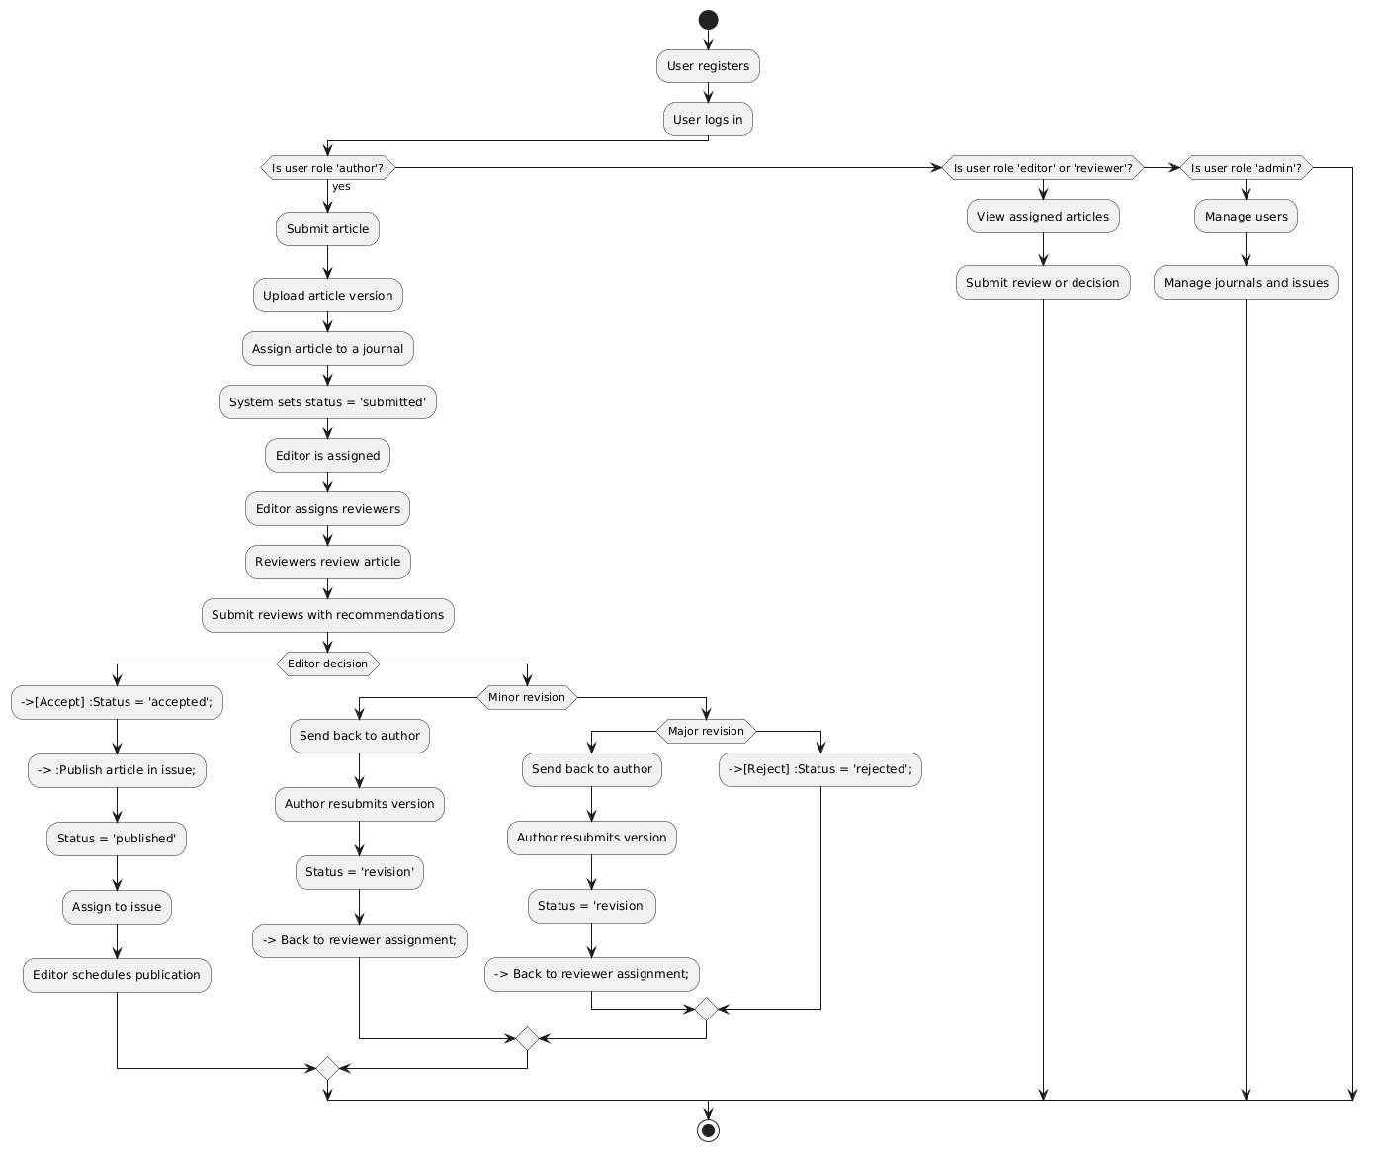
Activity Diagram (1/2)

Slide 9
Activity Diagram (2/2)
Link: https://drive.google.com/file/d/1PhhfahGCpKClnOeQA3EyesVWGl7QwW9T/view?usp=sharing

Slide 10
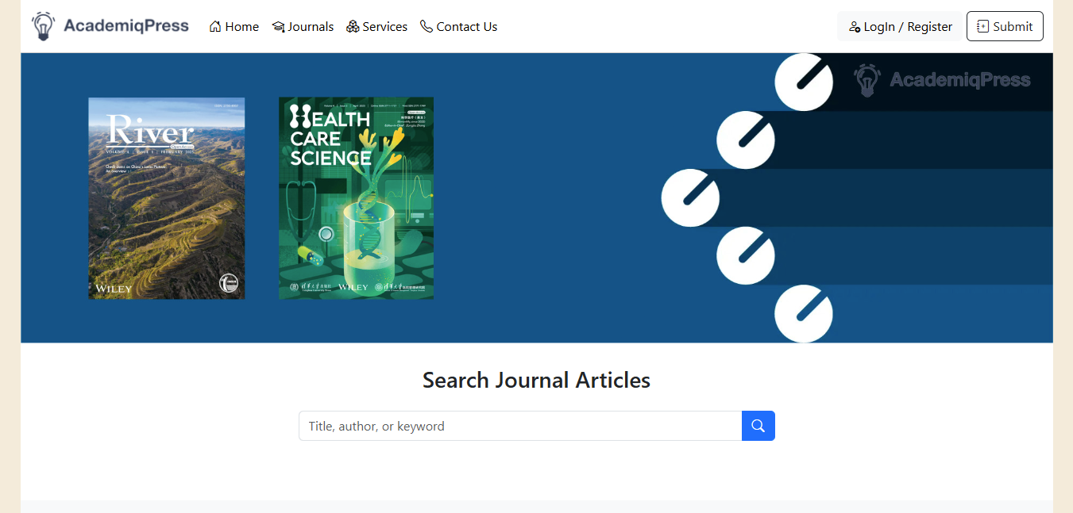
Home Page

Slide 11

Journal Page

Slide 12
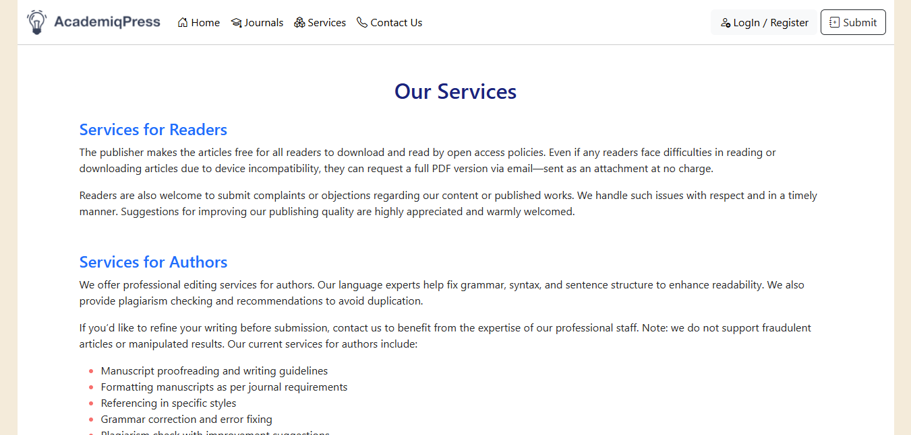
Service Page

Slide 13
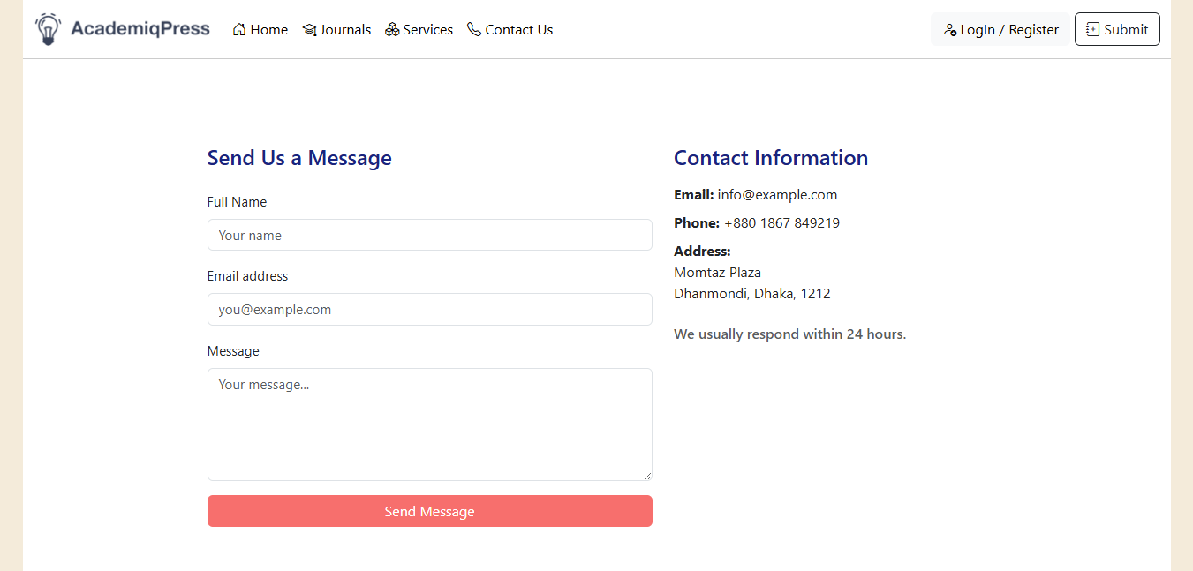
Contact Page

Slide 14
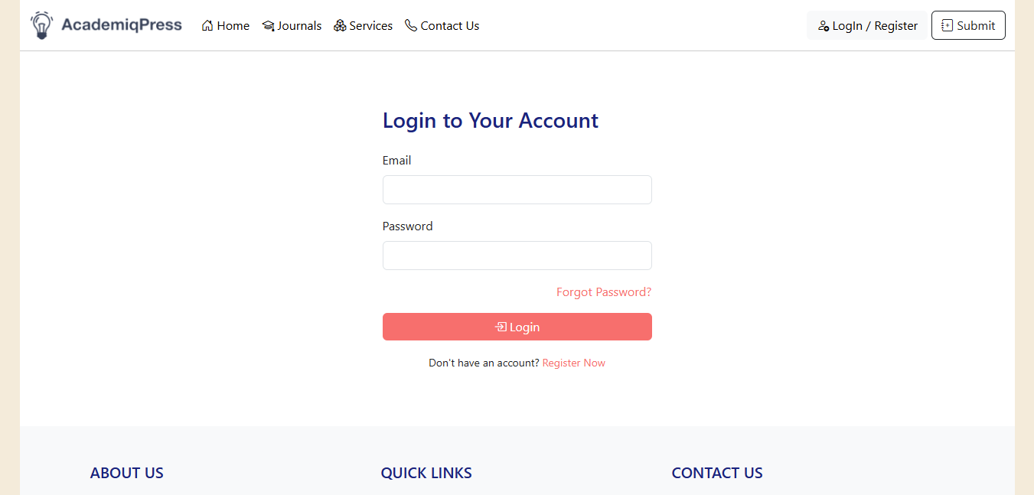
Login Page

Slide 15
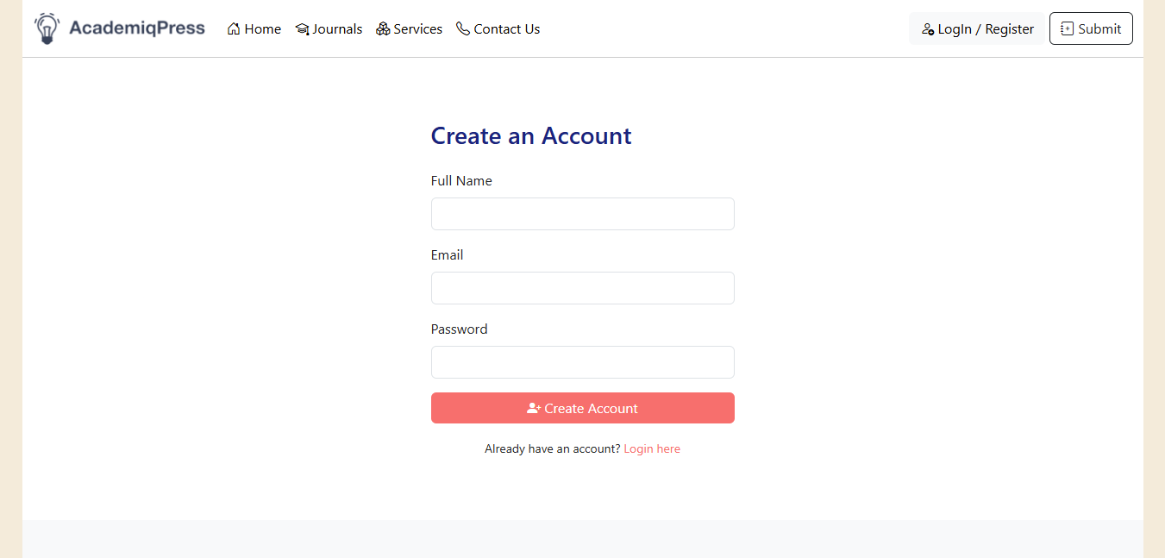
Registration Page

Slide 16
Thank You!

